Slide 1
MWA Project Planning Name: Eddy Lee An Ying Index No: 11 Class: S4-2
Read the instructions given in the box on every slide.
Complete the information in each slide
You can add more slides as needed

Slide 2
Project Theme
Instructions:
Clearly state the overall theme of your Adobe Animate project.
Example themes:
Fitness Fun
Interactive Sports Challenge
Product Showcase
Educational Game
fictional game

Slide 3
Project Purpose
Instructions:
Describe the purpose of your project.
Specify whether it's to:
Promote a sports event.
Advertise a new gym.
Promote a new product.
Create a simple game.
Or another clearly defined purpose.
Explain why you chose this particular purpose.
anything goes

Slide 4
Animation Description
Instructions:
Provide a detailed description of the animation you plan to create.
Describe the sequence of events, key movements, and overall style.
What will the user see happen on the screen?
Will it be a looping animation, or one that has a defined end?
not describable

Slide 5
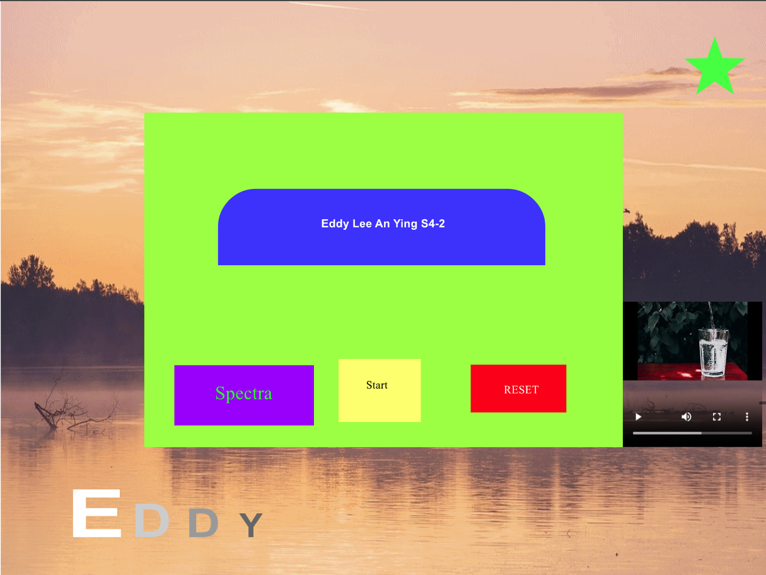
Opening Page Sketch
Instructions:
Create a rough sketch of your project's opening page.
Include:
Layout of visual elements.
Placement of buttons (e.g., "Start," "About," "Instructions").
If there will be a website link, show the location.
Label each element.
This can be a hand drawn sketch that is inserted into this slide
title
Start
Reset

Slide 6

Content Page Sketch
Instructions: Add more slides if you have many contents
Create a rough sketch of a representative content page.
Include:
Layout of content (text, images, interactive elements).
Placement of "Return" or navigation buttons.
How the user navigates through the content.
Label each element.
This can be a hand drawn sketch that is inserted into this slide
after start
Return
name
text

Slide 7


Image Identification
Instructions:
List all the images you plan to use in your animation.
Identify:
Characters.
Backgrounds.
Props.
Any other visual elements.
Where will the images come from? Original art, stock images, etc.

Slide 8
Image Attribution
Instructions:
If you are using images from external sources (e.g., stock photo websites, Creative Commons), provide proper attribution.
Examples:
Stock Photo: "Image: [Image Title] by [Artist Name] from [Website Name].
"Creative Commons: "Image: [Image Title] by [Artist Name] (CC BY-SA [Version Number]) from [Website Name].“
If the image is public domain, state that.
Provide the direct URL of the image source if possible.
If all images are original, state "All images are original works."
n/a

Slide 9
Lead up to Project Theme Selection
Ask yourself | Pen down your thoughts
What is the theme of your Project? | anything goes
What is the purpose of your animation? | anything goes
What is the story that you want to tell? | shapes

Slide 10
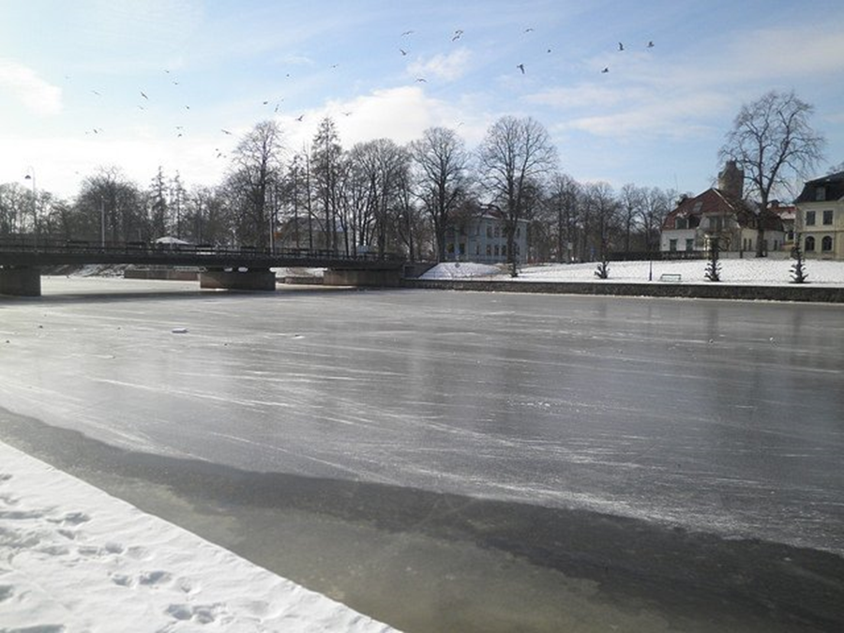
Attributing Images Example
Authors | Title | Source (e.g. Websites) | Licence
David J, | Winter in town | https://www.pixsy.com/image-licensing/correctly-attribute-images | CC BY 2.0

Slide 11
Project timeline
Period | Tasks | Status
Week 1 | Theme Selection
Week 2 | Source file is created and published in the required format
Week 3 | Media are used and integrated; also comply with copyright rules
Week 4 | Intro Animation is created based on project requirement
Week 5 | Intro Animation is created based on project requirement
Week 6 | Restart Button and 2 interaction buttons are created
Week 7 | Code is applied to user interaction component based on requirement – e.g. stop the animation; go to frame and play
Week 8 | Comments are written to explain the code
Week 9 | Test your animation on browser and refine your animation
Week 10 | What can be further improved?

Slide 12
Past Examples
https://sss.joycegsy.com/PeiEn/
https://sss.joycegsy.com/HongTing/
https://sss.joycegsy.com/Ezra/
https://sss.joycegsy.com/Aqmal/
https://the-king-12.github.io

